Slide 1

Game Mechanics

Slide 2
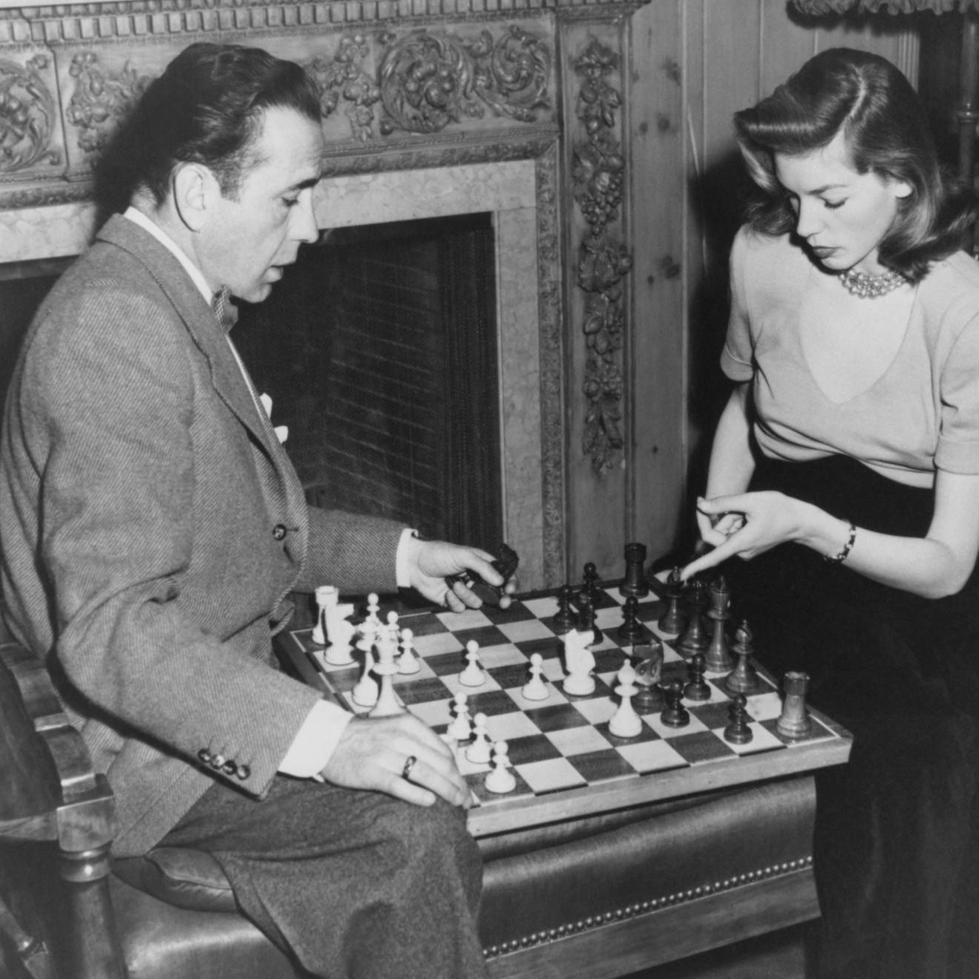
As designers, how can we give players interesting choices?
The answer is game mechanics!

Slide 3
Game mechanics are your tools to create different types of experiences for players.

Slide 4
Knowing game mechanics is essential to becoming literate in the medium of game design.

Slide 5
Mechanics
are the specific actions (physical or mental) players can take to play a game.

Slide 6
Mechanics:
What Players Do
Do you want players to move around the board? Trade resources? Move items from place to place?
Game mechanics give you the ability to make these things happen for your players.

Slide 7
Mechanics:
What Players Do
Using the right mechanics will allow players to make the choices that make sense for your game.
The good news is--you already know a lot of game mechanics!

Slide 8
Mechanics: How Your Game Works
Think of mechanics as the gears that run your game machine. A theme can have many different mechanics applied to that theme and each would result in a very different game.
How would a game about selling diamonds play differently if players collect sets of them versus delivering them across the board?

Slide 9
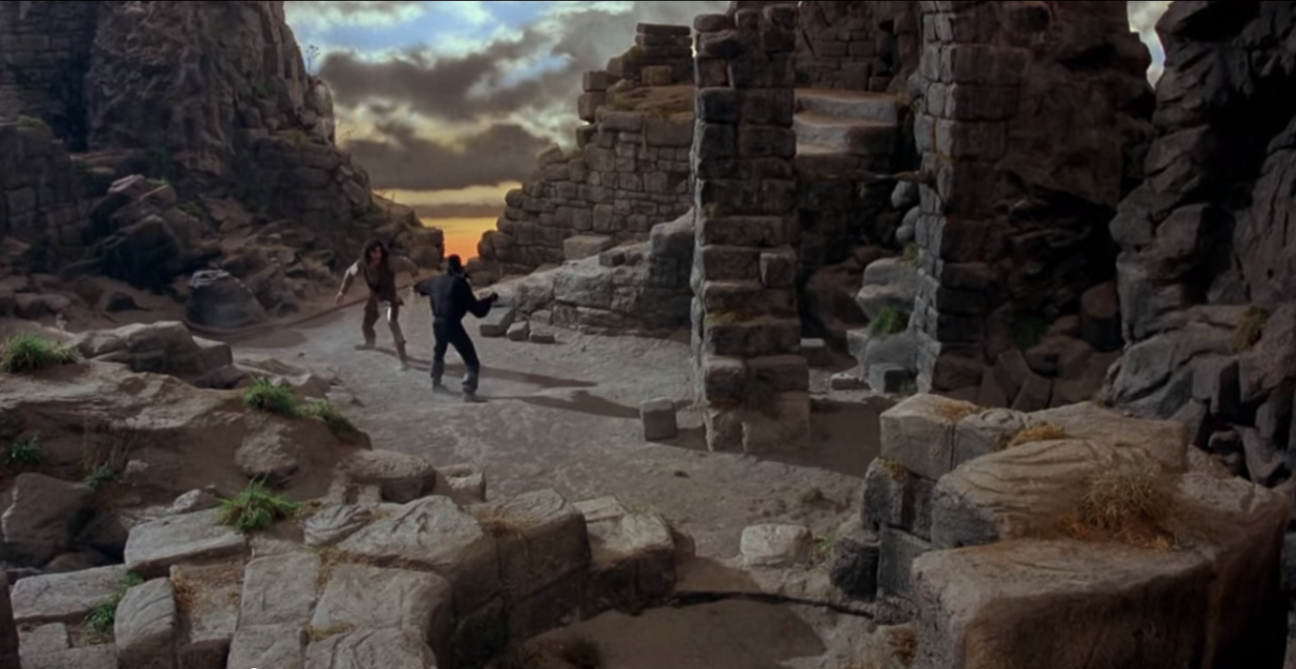
Remember this scene from The Princess Bride?
They were discussing actual sword fighting strategies.
Inigo Montoya: You are using Bonetti’s Defense against me, ah?
Man in Black: I thought it fitting considering the rocky terrain.
Inigo: Naturally, you must suspect me to attack with Capo Ferro?
Man in Black: Naturally, but I find that Thibault cancels out Capa Ferro. Don’t you?
Inigo: Unless the enemy has studied his Agrippa… which I have.
Game mechanics are much easier to learn.

Slide 10
Game Mechanics You’ve Experienced
Roll and Move (Clue, Monopoly, Chutes and Ladders, Candyland, Life, Sorry!)
Set Collection (Go Fish!, Gin/Rummy, Monopoly)
Dice Rolling (Yahtzee, Risk)
Card Drafting (MTG, Rummy, Hearts)
Hand Management (Clue, Uno, Mahjohng)

Slide 11
Modern Game Mechanics
Examples include Pick Up and Deliver, Area Control, Simultaneous Action Selection, Push Your Luck, Route/Network Building, Area Movement, and more.
Just from the names, you can get a sense of the different types of actions players can take.

Slide 12
50ish Game Mechanics
Acting
Action Queue
Action Selection
Area Control/Influence
Area Enclosure
Area Movement
Auction/Bidding
Betting/Wagering
Campaign Battle Card
Card Drafting
Chit Pull
Commodity Speculation
Cooperative Play
Crayon Rail System
Deck Building
Dexterity
Dice Rolling
Grid Movement
Hand Management
Hex and Counter
Hidden Traitor

Slide 13
50ish Game Mechanics
Line Drawing
Memory
Modular Board
Paper and Pencil
Partnerships
Pattern Building
Pattern Recognition
Pickup and Deliver
Player Elimination
Point to Point Movement
Press Your Luck
Rock Paper Scissors
Roll and Move
Roundel Wheel
Route/Network Building
Secret Unit Deployment
Set Collection
Simulation
Simultaneous Action Selection
Singing

Slide 14
50ish Game Mechanics
Stock Holding
Storytelling
Take That
Tile Placement
Time Track
Trading
Trick Taking
Variable Phase Order
Variable Player Powers
Voting
Worker Placement
To learn more about individual mechanics, go to www.boardgamegeek.com/ browse/boardgamemechanic
The original 50ish mechanics have been expanded into many, many more.

Slide 15
Mechanics
I sort mechanics by function in games, which helps to understand and use them.

Slide 16
Mechanics
Sorted By Function
Control player choices
Physical interaction with the gaming space
Mechanics that control player movement
Player interaction mechanics
Classic mechanics
Abstract-ish mechanics
Specialized-purpose mechanics

Slide 17
Control Player Choices
These mechanics allow a game designer to specifically control the number of actions as well as how and when a player takes their actions.

Slide 18
Control Player Choices
Action Queue
Action Selection
Simultaneous Action Selection
Worker Placement
Push Your Luck
Roundel Wheel
Time Track
Variable Phase Order

Slide 19

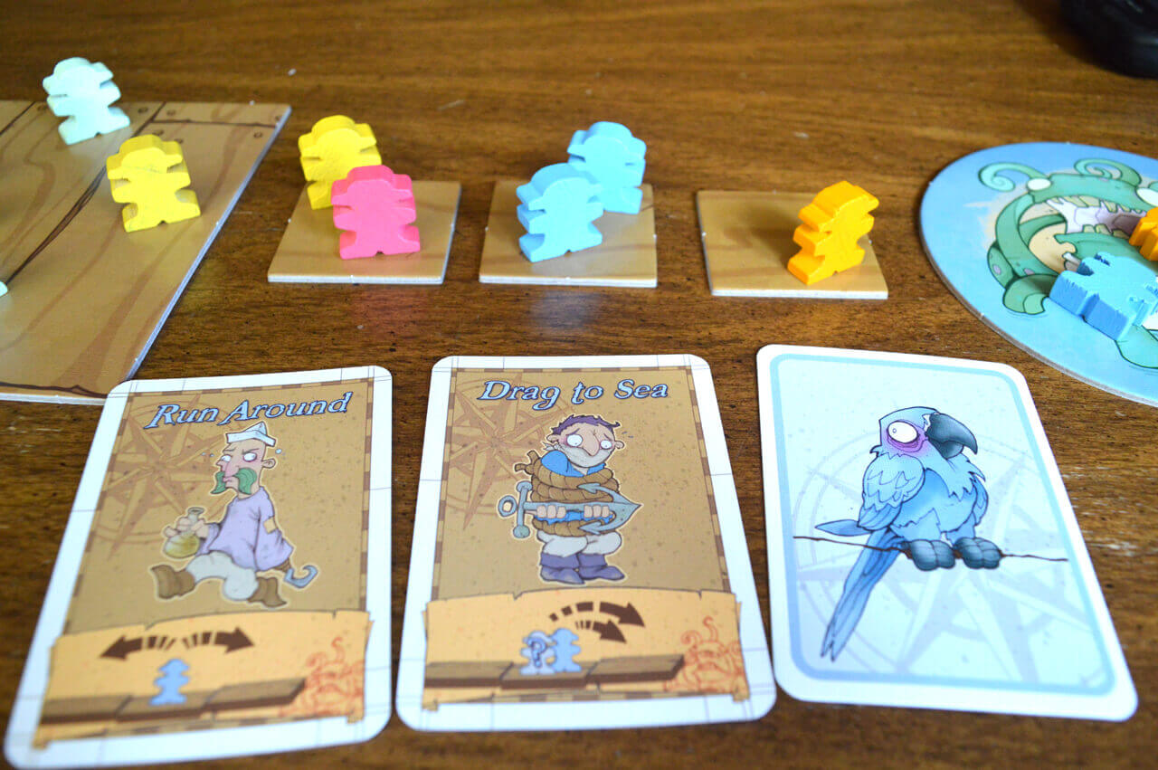
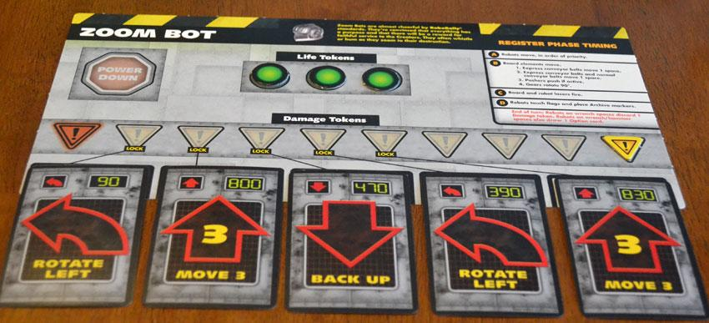
Action Queue
Players plan several actions at once by playing several tiles, cards, etc., in a series, and take their actions in that order.
(Walk the Plank, RoboRally)

Slide 20
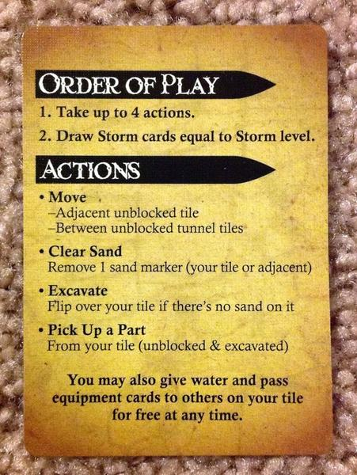

Action Selection
Players choose actions they want to take, limited by the specific number of actions that can be taken on a turn.
(Forbidden Desert)

Slide 21

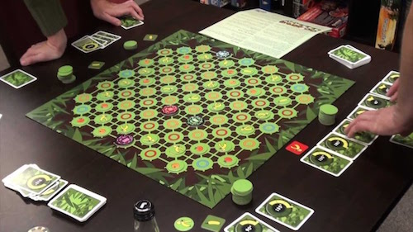
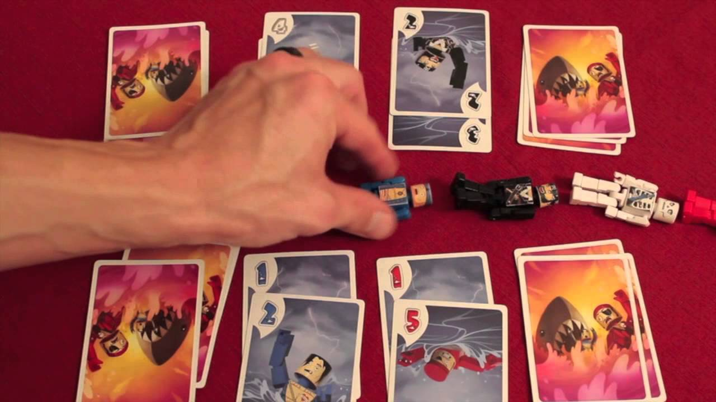
Simultaneous Action Selection
Players choose and reveal a card simultaneously, which are then resolved in some way.
(Spin Monkeys, Get Bit!)

Slide 22

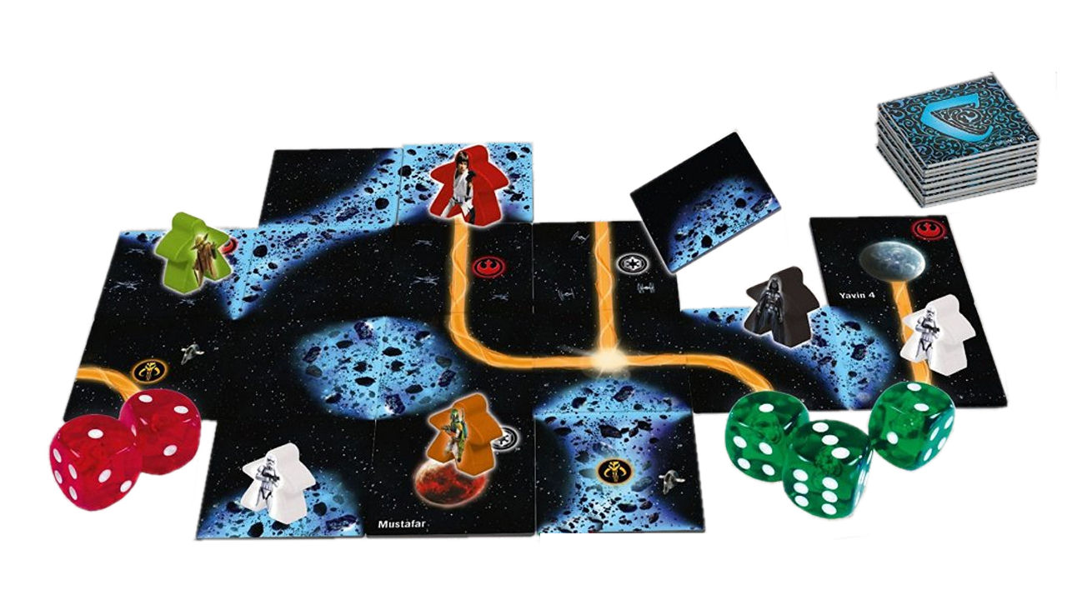
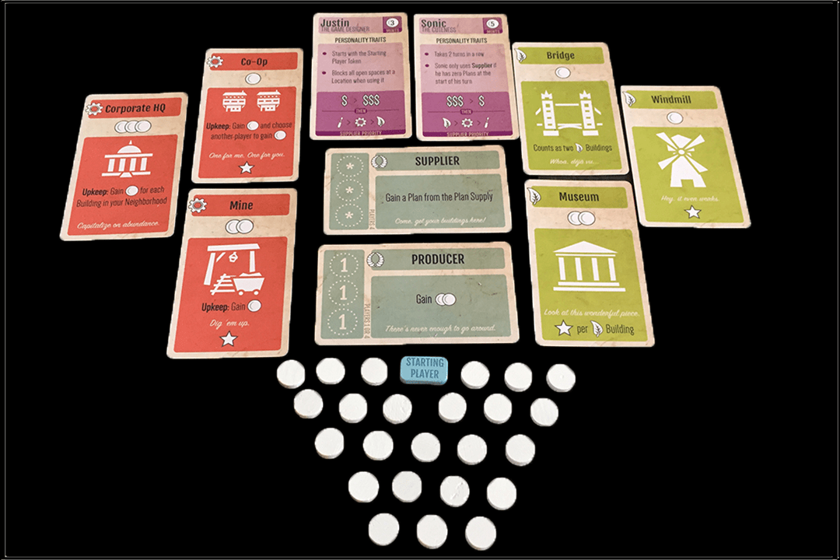
Worker Placement
Each player has a pool of meeples and places them on shared spaces to claim actions resources, or benefits.
(Star Wars Carcassonne, Mint Works)

Slide 23

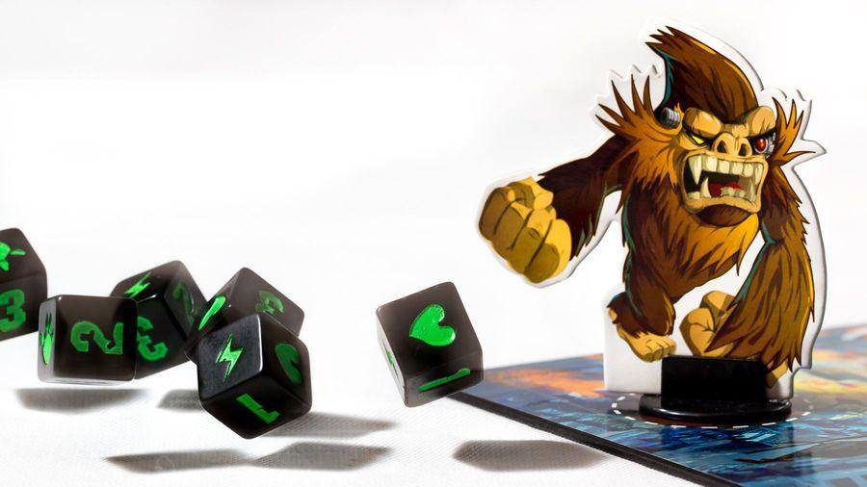
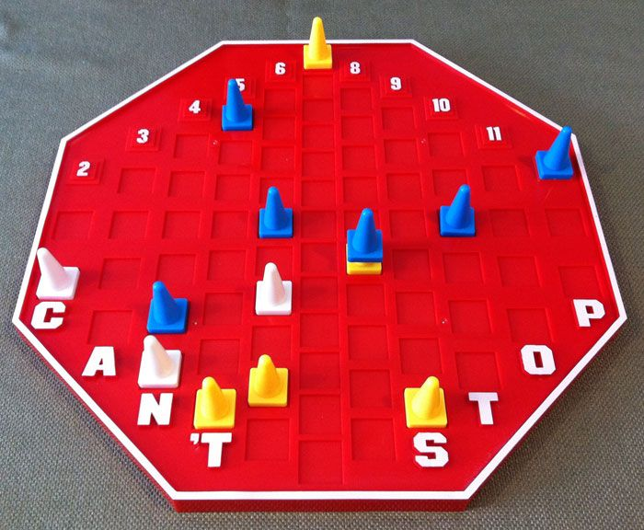
Push Your Luck
Players take actions as desired, but as possible gain increases, so does the possibility of loss of progress if an adverse condition presents itself.
(King of Tokyo, Can’t Stop)

Slide 24

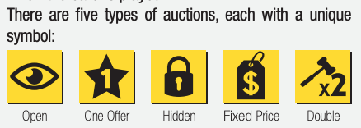
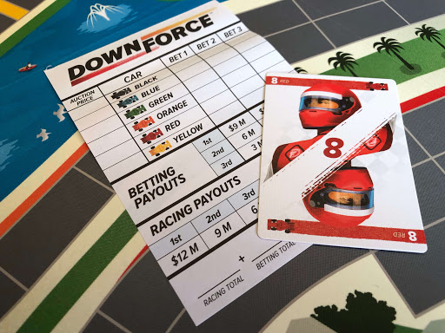
Auction/Bidding
Players compete head to head for elements of value in the game, and players determine the value of those elements.
(Modern Art, Downforce)

Slide 25
Gaming Space Interaction
These are mechanics that players can use to build, connect, and control areas on the game board or gaming space. Some of this may take place during setup, others might occur during the game.

Slide 26
Gaming Space Interaction
Area Majority/Influence
Area Enclosure
Modular Board
Route/Network Building
Tile Placement
Crayon Rail System

Slide 27

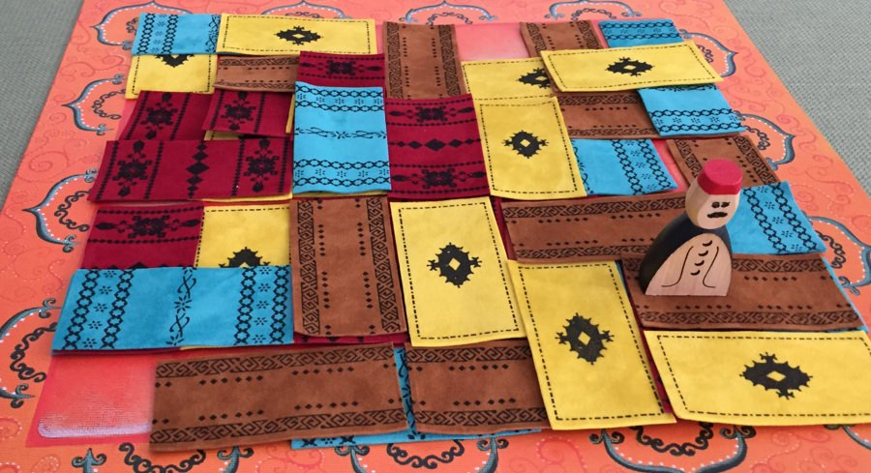
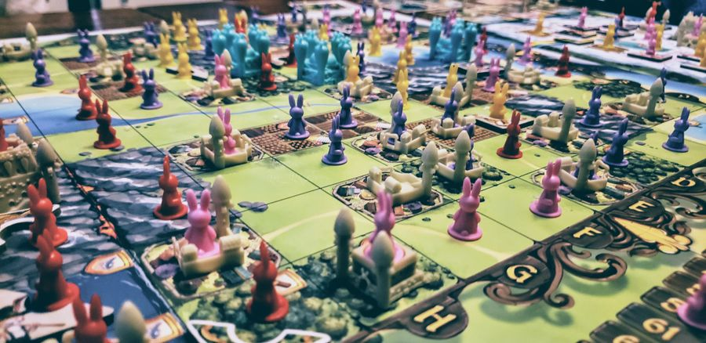
Area Majority/
Influence
Players occupy spaces to gain benefits based on their proportional presence in the space.
(Marrakech, Bunny Kingdom)

Slide 28
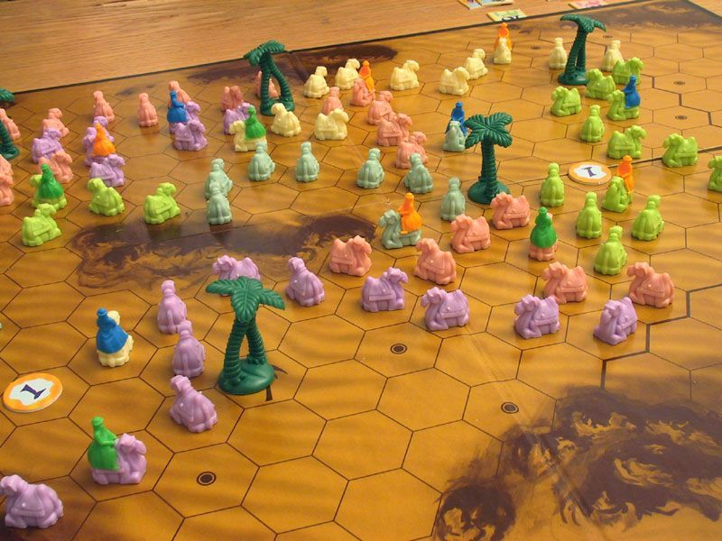

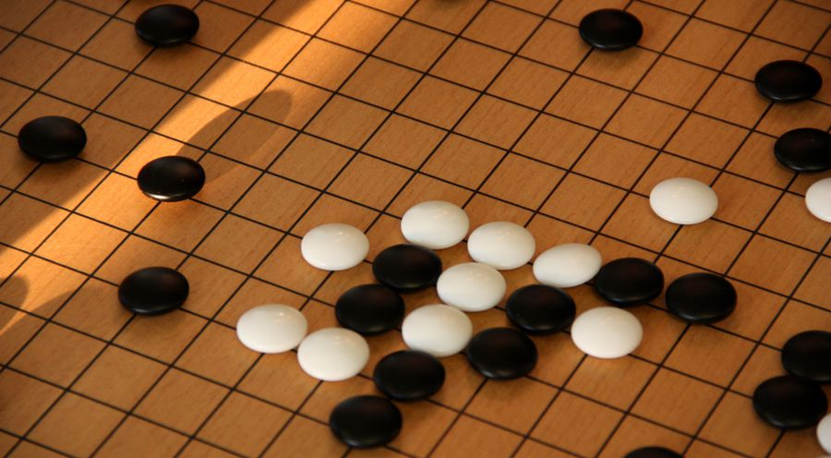
Area Enclosure
Players place or move pieces to block or surround sections of the board.
(Through the Desert, Go)

Slide 29
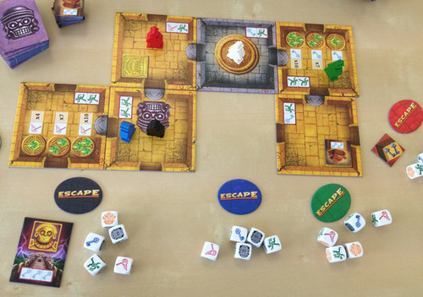

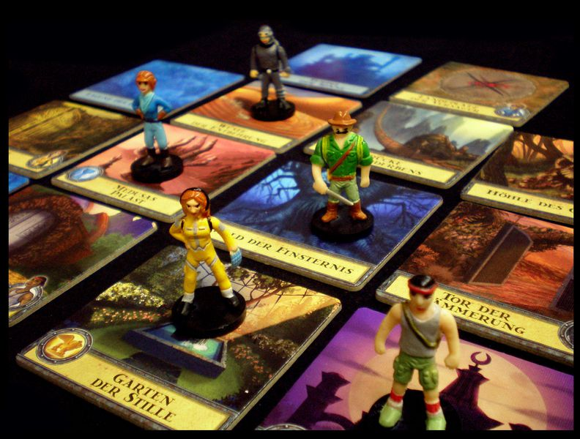
Modular Board
The board is comprised of individual units that can be combined in different ways for strategy and exploration.
(Escape: Curse of the Temple)

Slide 30

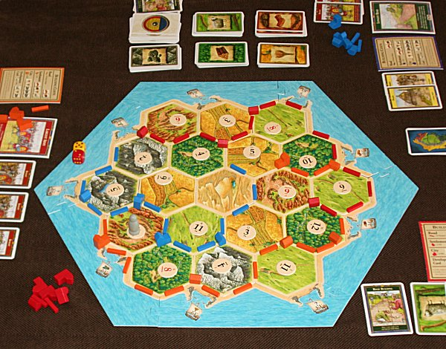
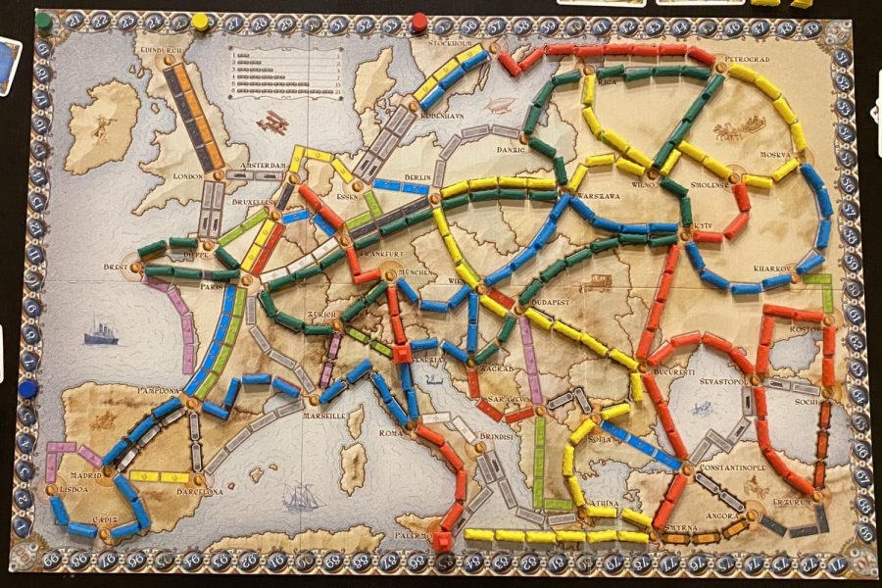
Route/Network Building
Players create a network between different locations.
(Catan, Ticket to Ride)

Slide 31

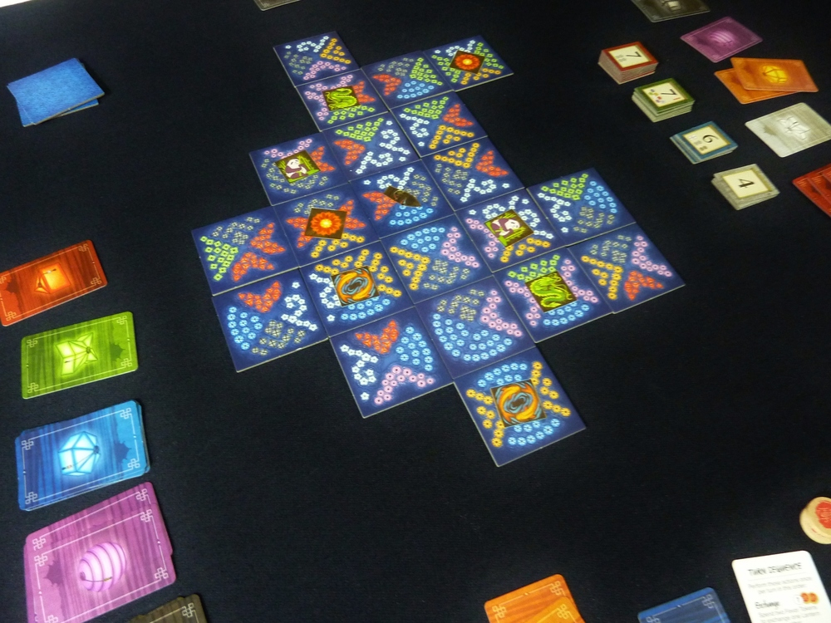
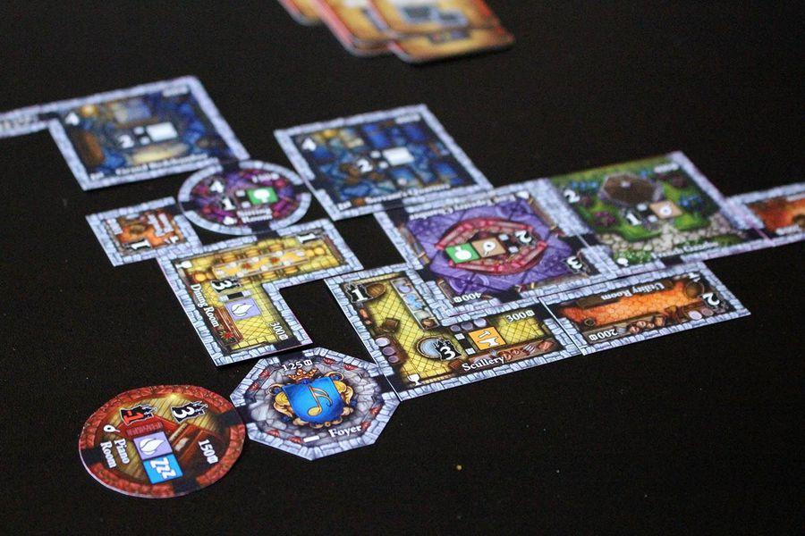
Tile Placement
Players place tiles to score VPs or trigger abilities, often based on adjacent pieces or pieces in the same group/cluster for various scoring methods.
(Lanterns, Castles of Mad King Ludwig)

Slide 32
Player Movement
These mechanics provide different ways to have players move their pawns around the game board or space.

Slide 33
Player Movement
Area Movement
Grid Movement
Point to Point Movement
Roll and Move

Slide 34
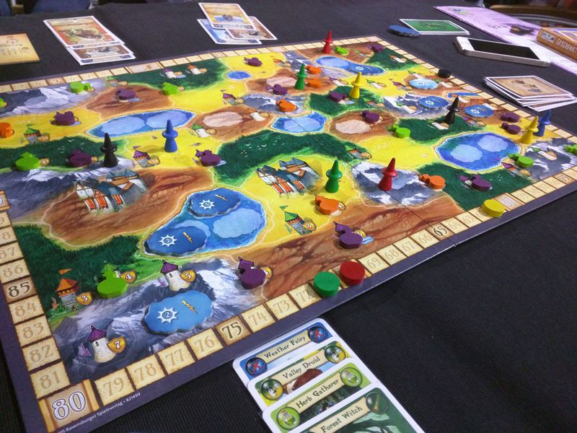
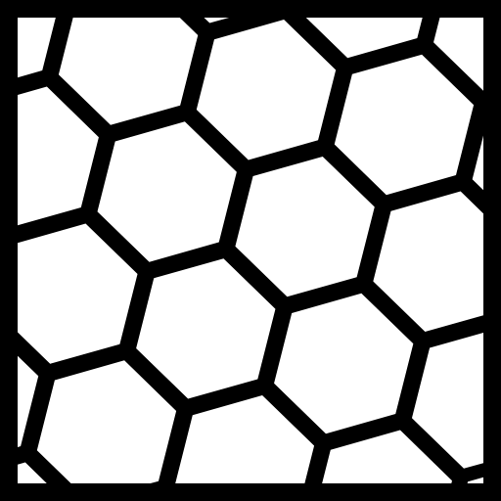
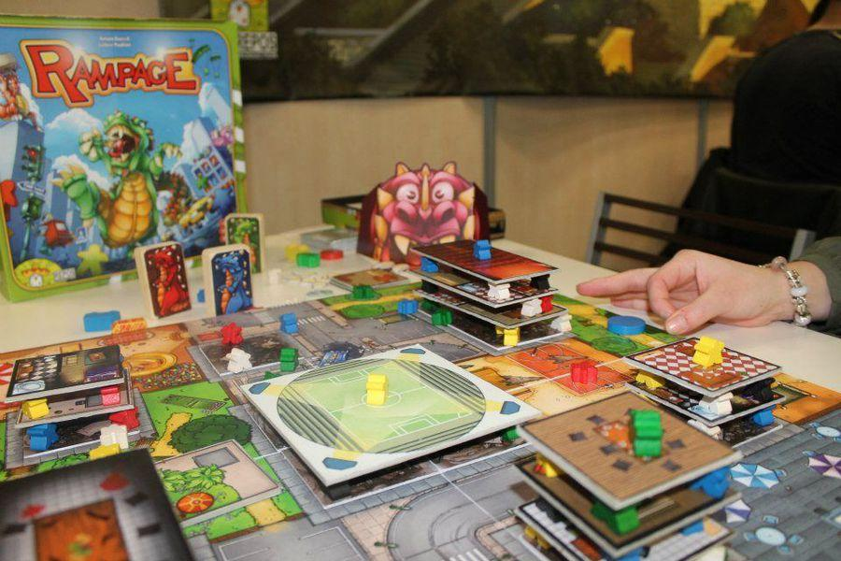
Area Movement
Players move pawns across irregularly shaped spaces on the board.
(Broom Service, Terror in Meeple City )

Slide 35

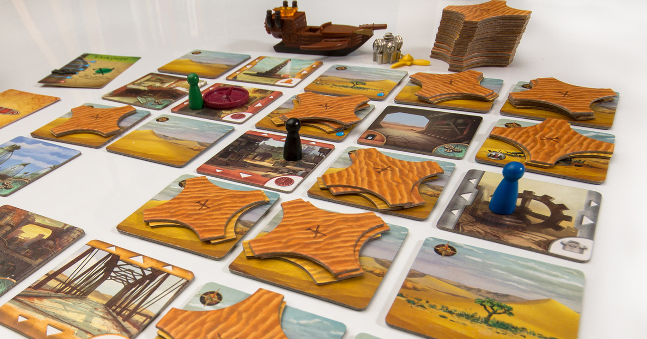
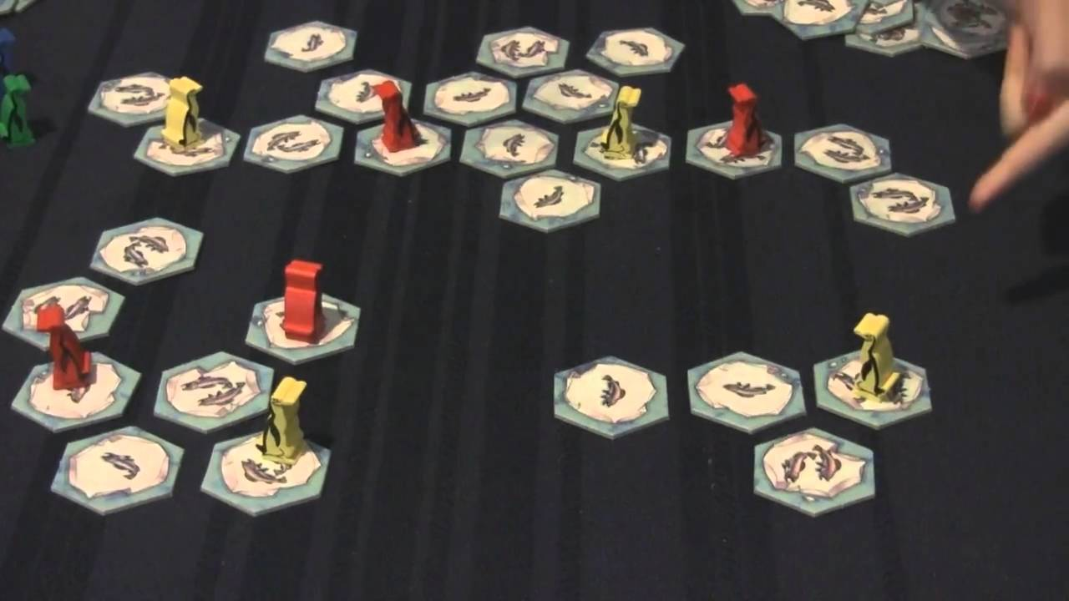
Grid Movement
Players move pawns on the grid (square or hexagonal) in many directions.
Forbidden Desert, Hey That’s My Fish)

Slide 36

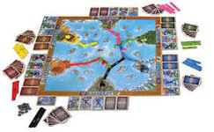
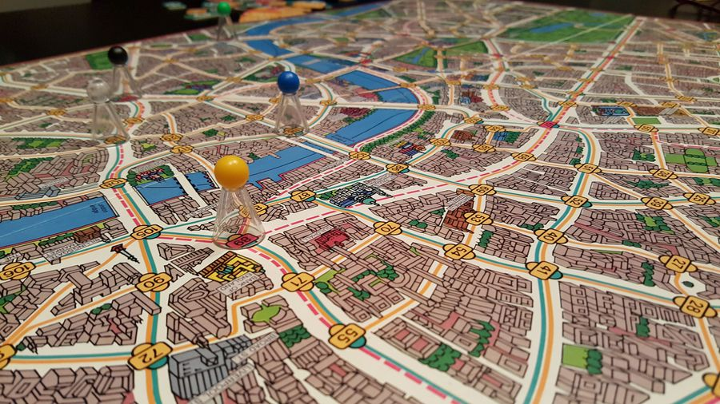
Point to Point Movement
Players move their pawns across the board only along specific pathways.
(River Dragons, Scotland Yard)

Slide 37
Player Interaction Mechanics
These mechanics provide out of turn interaction between players, so impact on the other players is greatest.

Slide 38
Player Interaction Mechanics
Auction/Bidding
Take That
Trading
Betting/Wagering
Partnerships
Player Elimination
Voting
Acting
Cooperative Play
Role Playing

Slide 39
Auction/Bidding
Players compete head to head for elements of value in the game, and players determine the value of those elements.
(Modern Art, Downforce)

Slide 40
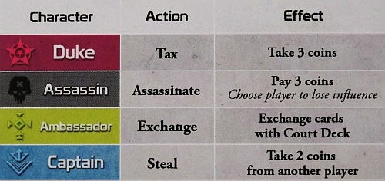

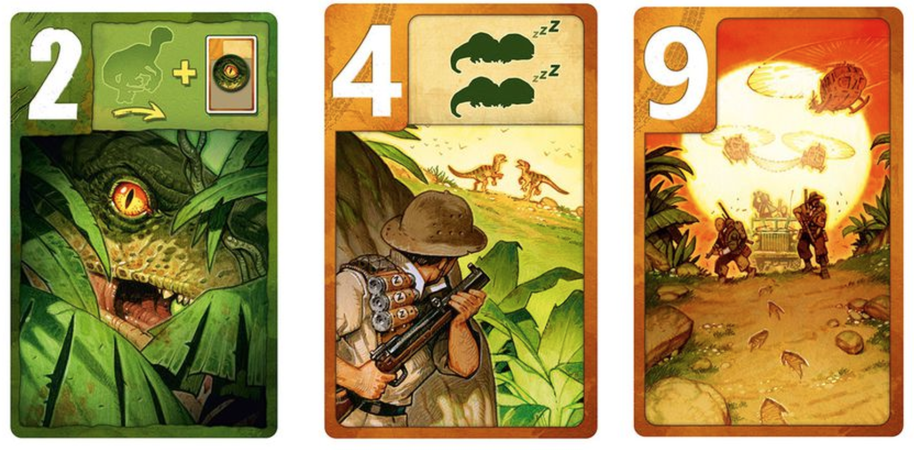
Take That
Maneuvers that directly attack an opposing player or do something else to impede their progress.
(Coup, Raptor)

Slide 41
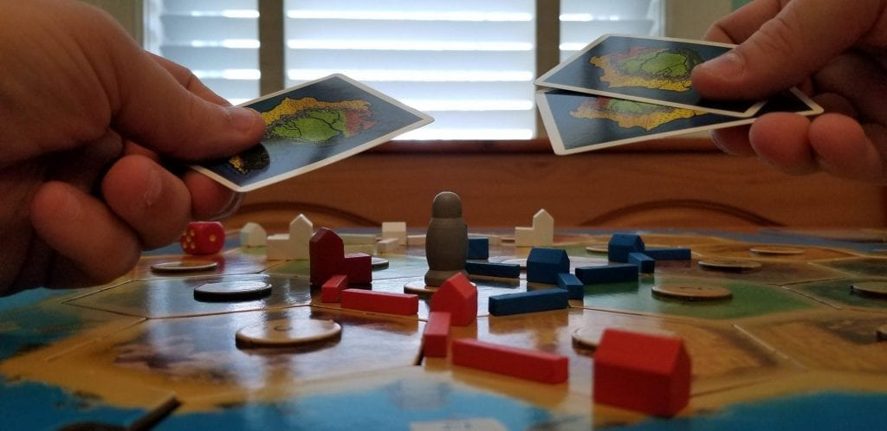

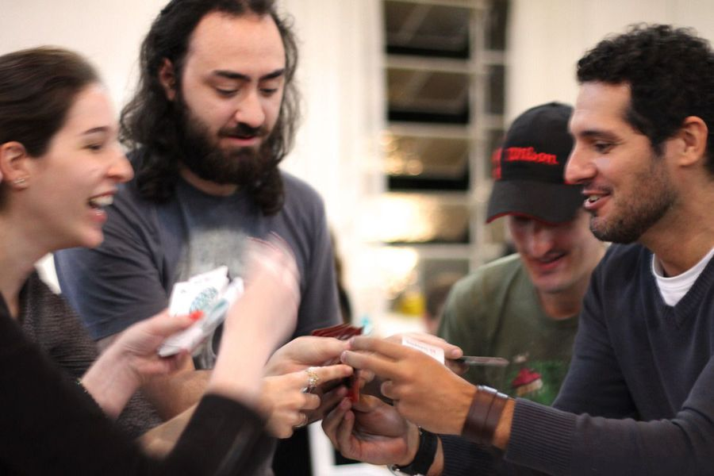
Trading
Players exchange resources or other game elements amongst each other (or the bank).
(Catan, Pit)

Slide 42
Classic Mechanics
These mechanics are common and can be readily adapted to almost any theme.

Slide 43
Classic Mechanics
Card Drafting
Campaign Battle Card
Chit Pull
Dice Rolling
Hand Management
Trick Taking
Hex and Counter
Simulation

Slide 44
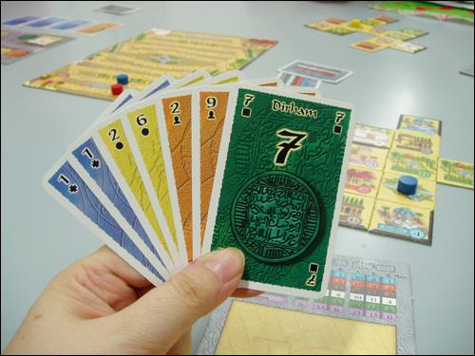

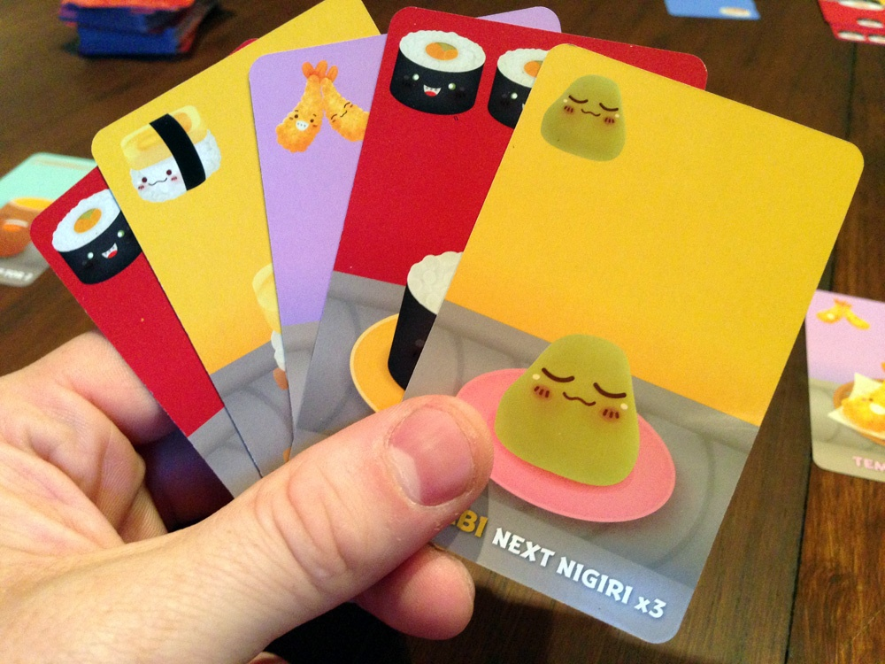
Card Drafting
Players choose cards from available choices.
(Alhambra, Sushi Go)

Slide 45

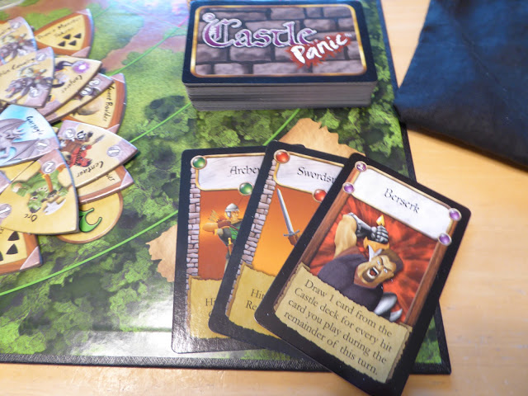
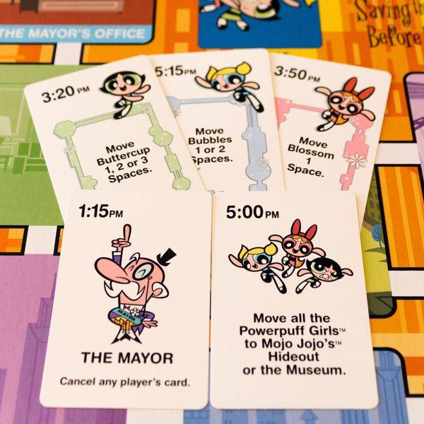
Campaign/
Battle Card
Cards have specific abilities, and players’ choices are restricted to those held in hand.
(Castle Panic, Powerpuff Girls Saving the World Before Bedtime)

Slide 46

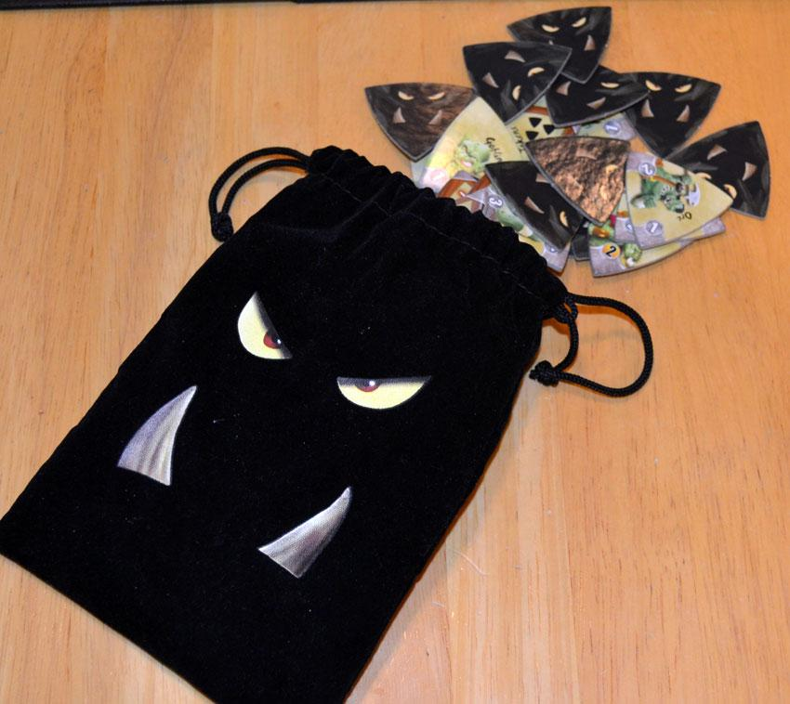
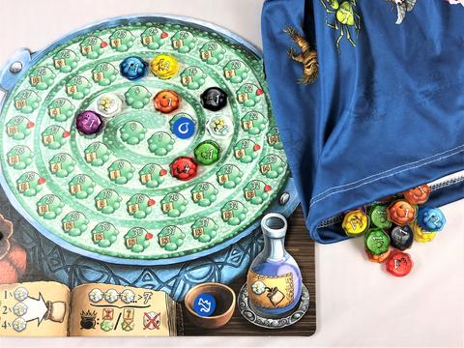
Chit Pull
Tokens are introduced during the game by pulling from a bag or pile.
(Castle Panic, Quacks of Quedlinburg)

Slide 47
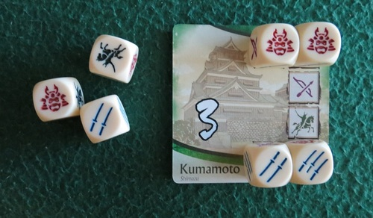

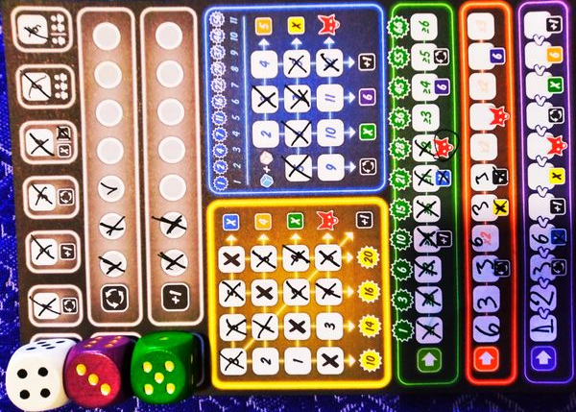
Dice Rolling
Rolling dice determines the outcome of specific actions or choices available to players.
(Age of War, That’s So Clever)

Slide 48

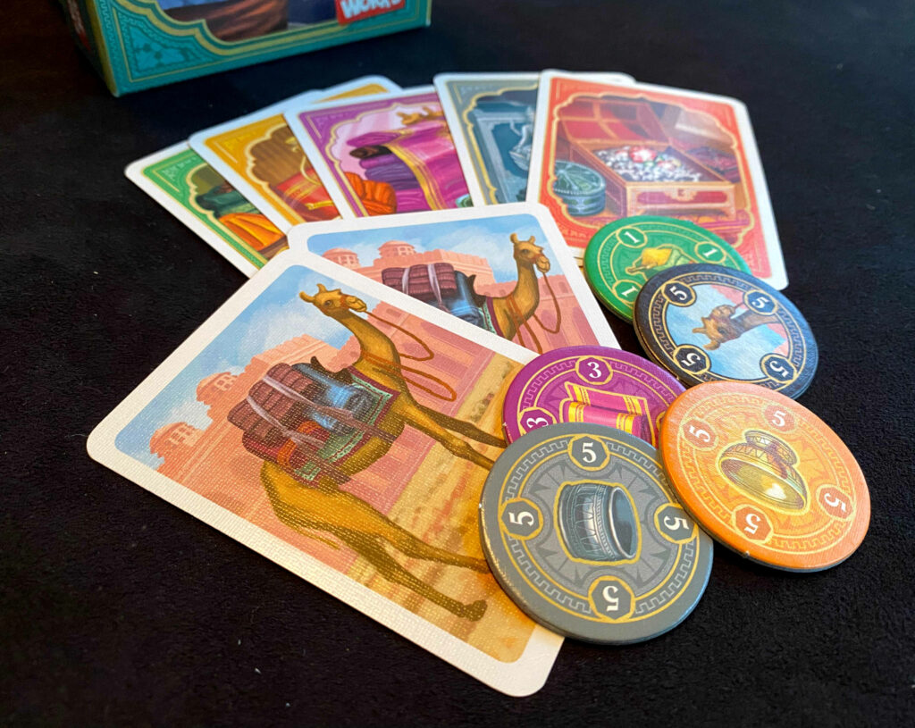
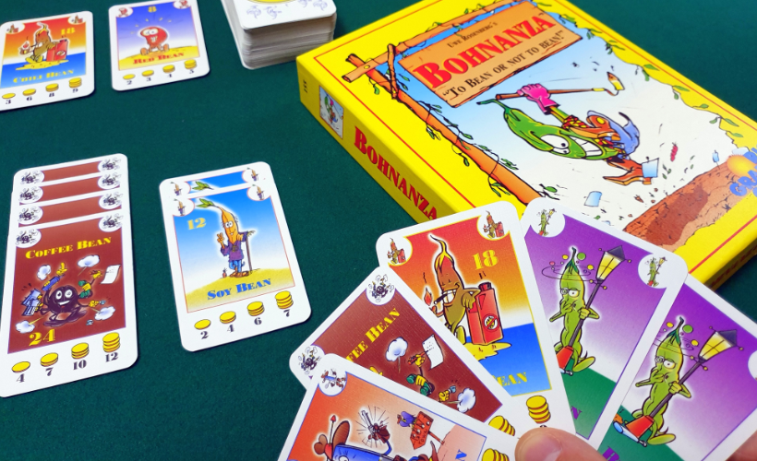
Hand Management
Players choose from cards or tiles in hand to play.
(Jaipur, Bohnanza)

Slide 49
Abstract-ish Mechanics
These mechanics define the game, which often have no theme or the theme is entirely “pasted on.”

Slide 50
Abstract-ish Mechanics
Pattern Building
Set Collection
Pattern Recognition
Memory

Slide 51
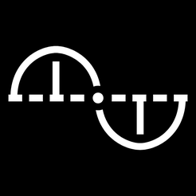
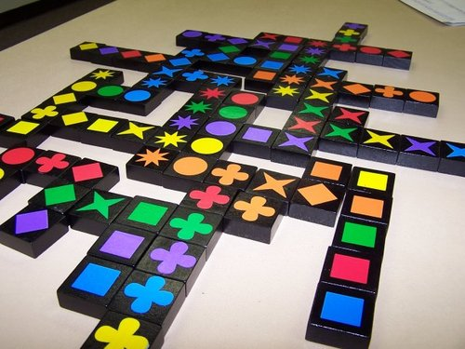
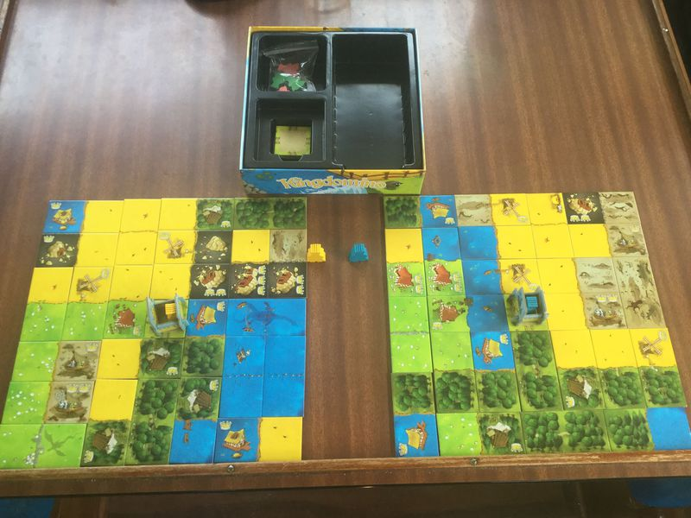
Pattern Building
Players use game resources to construct patterns on the board.
(Qwirkle, Kingdomino)

Slide 52

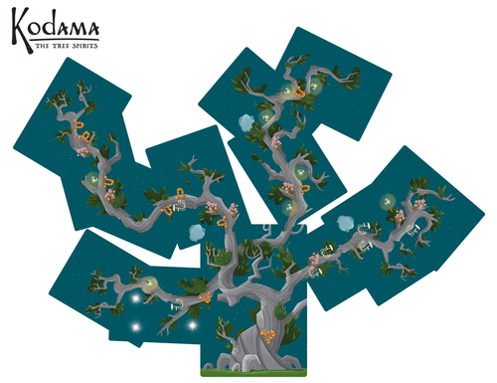
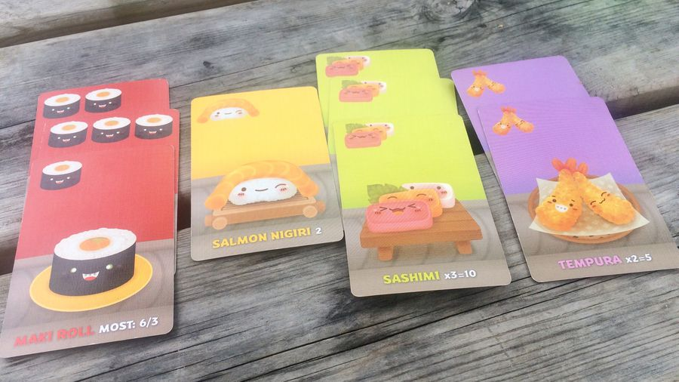
Set Collection
Players collect sets of game elements which are then used for scoring or some other purpose.
(Kodama, Sushi Go)

Slide 53
Specialized Purpose Mechanics
These mechanics provide their own unique ways to play games, based on their function.

Slide 54
Specialized Purpose Mechanics
Pickup and Deliver
Secret Unit Deployment
Variable Player Powers
Deck/Pool Building
Paper and Pencil
Commodity Speculation
Roll and Place

Slide 55
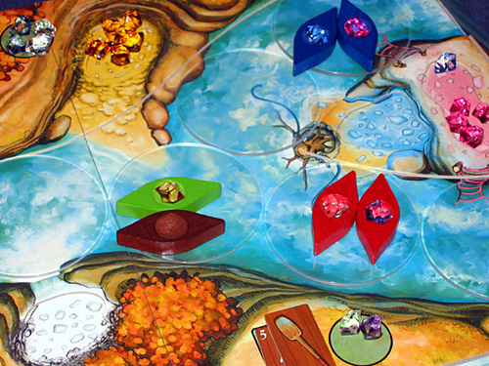


Pickup & Deliver
Players gather resources from specific places on the board and transport them across the board to deliver them to other areas.
(Niagara, Horrified)

Slide 56



Secret Unit Deployment
Only the player controlling certain playing pieces has perfect information about the nature (or even the whereabouts) of those pieces.
(Survive, Jaws)

Slide 57



Variable Player Powers
Each player has special actions that only they can perform, or that modify standard actions.
(Avalon, Cosmic Encounter)

Slide 58
Mechanics
Which mechanics make sense for your game?

